Slide 1
Text Mining Project
WS 17/18
Umair Javed
Anas Siddiqi
Muhammad Zohaib Khan
April 3, 2018

Slide 2
Overview
Semantic Linking for Event-Based Classification of Tweets.

Slide 3
Source Control
BitBucket is used for source code management
https://bitbucket.org/mzohaibkhan/text-mining

Slide 4
Challenges
No Context Information
Non-event tweets
Syntactic problems
Difficult to detect event due to lack of context information in tweets.
Most of tweets not related to any event.
Spelling and grammatical mistakes, use of casual mixed/informal language

Slide 5
Project objectives:
Multi-class classification, or Ordinal classification of tweets data
Extracting and linking Named Entities in tweets.
Use different machine learning algorithms to train and test tweets, and validate results
Classifying Event Tweets

Slide 6
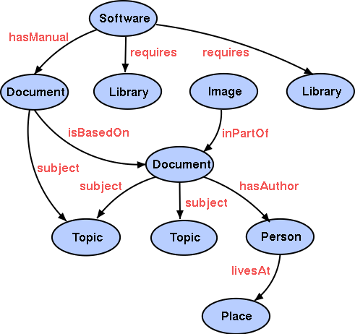
Semantic Linking

Slide 7
Semantic Linking of Named Entities
Various available Extractor:
AlchemyAPI
Dandelion API
TextRazor
Saplo
Wikimeta
Zemanta
Popular Ontologies:
DBpedia(NERD)
YAGO
IBM Watson

Slide 8
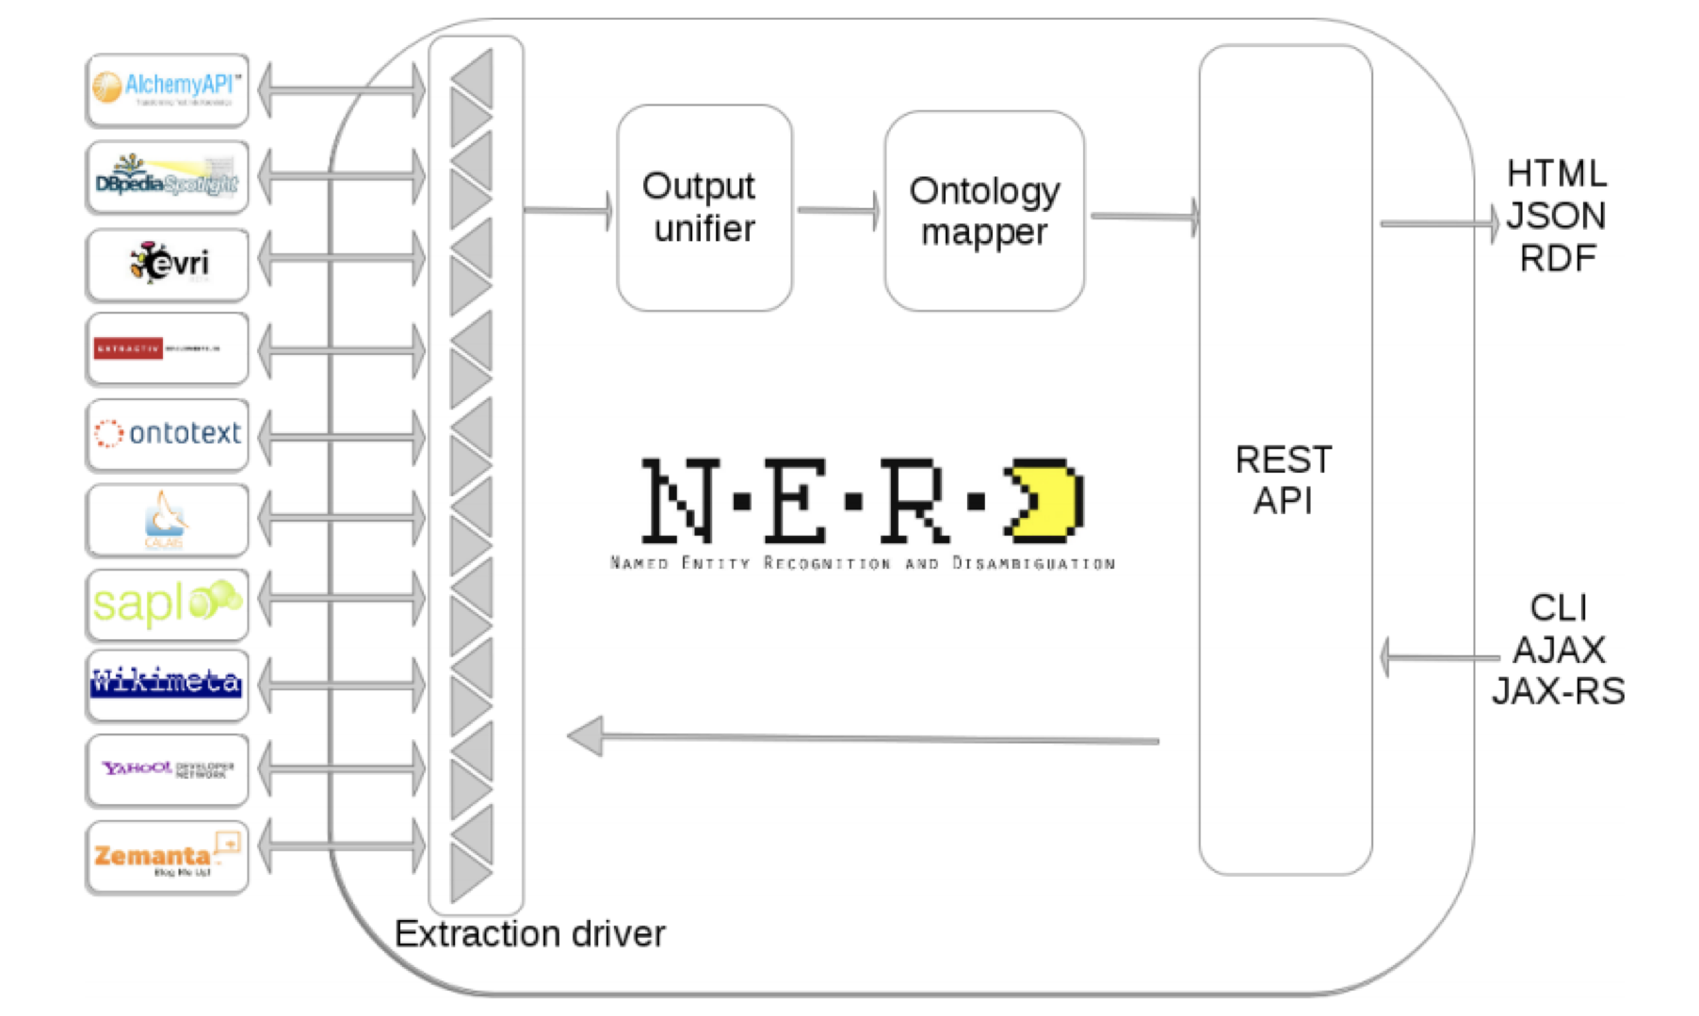

Slide 9
Datasets

Slide 10
Event based and General Datasets
Event related datasets from social sensor’s site.
General dataset from twitter stream.
Event | Tweets
Fifa Cup | 200k
Super Tuesday | 400k
US Elections | 3200k
General Category | 300k

Slide 11
Detecting and Classifying Event Tweets
• Preprocessing
• Named entity linking and replacement
• Feature extraction
• Tweet classification
• Evaluation

Slide 12
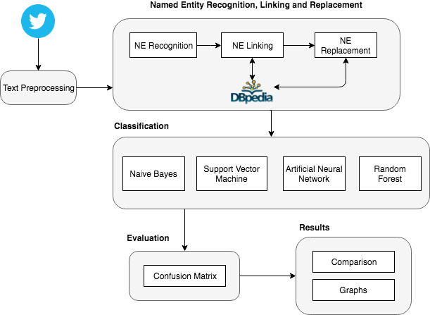
Architecture

Slide 13
Preprocessing
Removing twitter specific text
Extra spaces, multiple characters removal
Lemmatization

Slide 14
Name Entities Linking Replacement

Slide 15
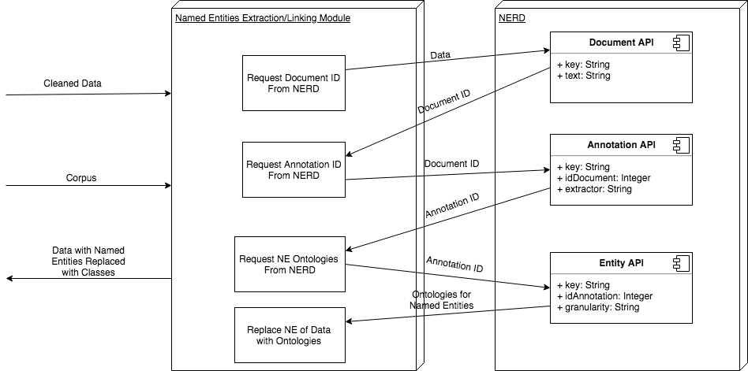

Slide 16
Feature Extraction

Slide 17
Feature Extraction
Term Frequency/Inverse Document Frequency:
Statistical Measure
How important a word is to whole corpus
Directly proportional to number of times a word appears
TimeStamps
Highly useful for detecting events
Event Related tweets are closer in time

Slide 18
Classification

Slide 19
Classification
Supervised Machine Learning Algorithms
Training data / Test data
Goal: Estimate a mapping function to generalise for new (unseen) input

Slide 20
Classifiers
Naive Bayes Classifier
Probabilistic Classifier based on Bayes Theorem
Support Vector Machine
Find a hyperplane that divides data
Artificial Neural Network
Similar to neurons in human brain
Multiple layers, input layer, hidden layers, output layer
Random Forest
Large number of decision trees

Slide 21
Evaluation
Calculated using Confusion Matrix
Precision
Recall
F-1 Measure
Accuracy

Slide 22
Results

Slide 23
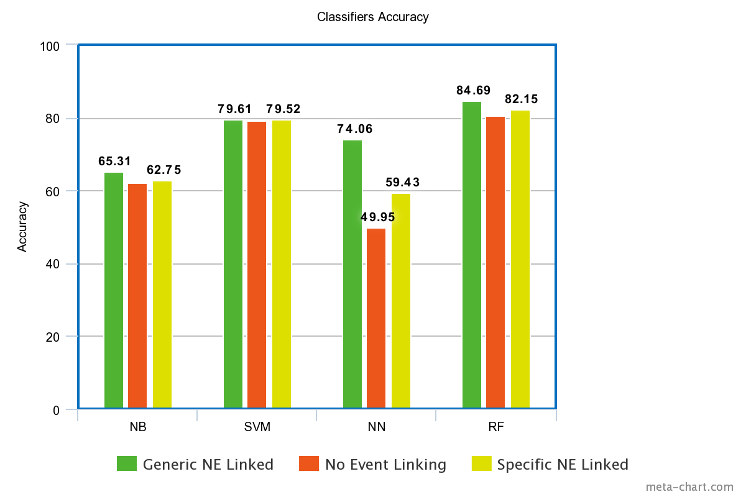

Slide 24
Future Work

Slide 25
Future Work
Adding more events in dataset.
Including more classifiers.
Using other extractors and ontologies for semantic linking

Slide 26
Demo

